Slide 1

Evolution of language models
Dr Chiranjib Sur
Mehta Family School of DS and AI, IIT Guwahati

Slide 2
Objective
Evolution in Language models
Notes:
Paradigm Shift : Only being a Language Model to Language Model and Embedding to being a pre-trained or foundation model for all NLP tasks

Slide 3
Neural Language Model
Pre-Transformer Era

Slide 4
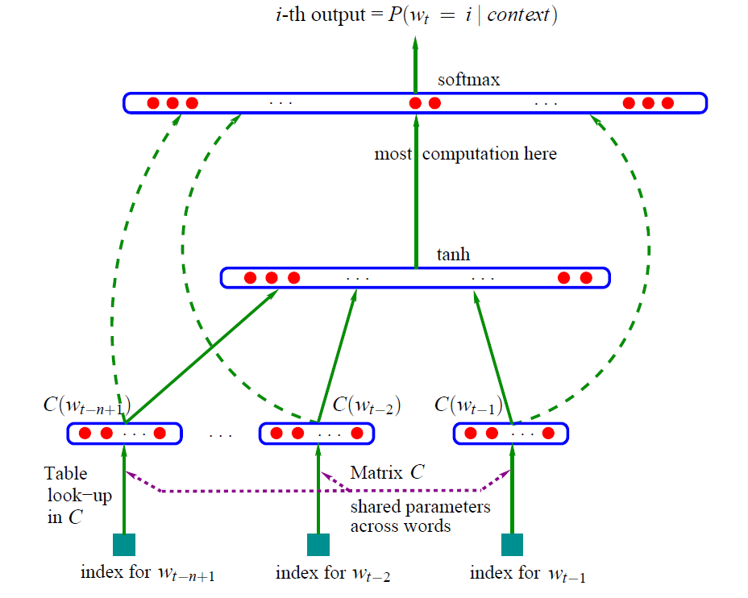
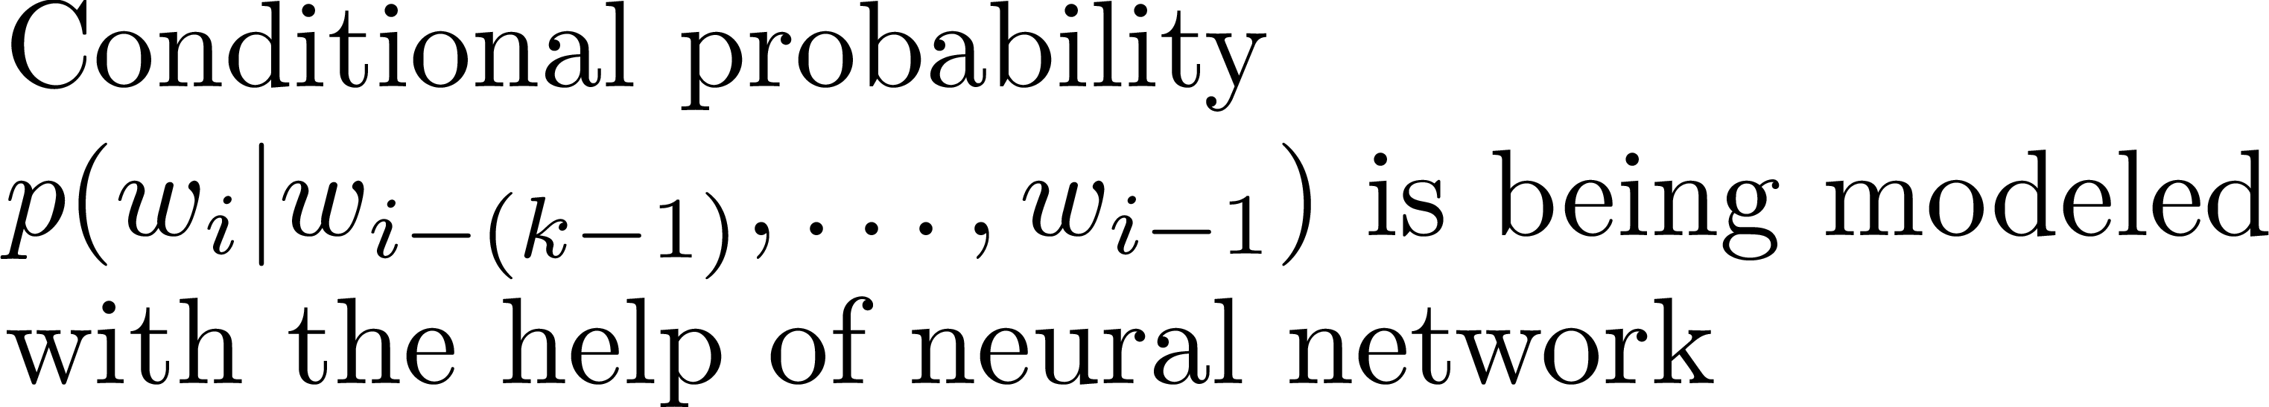
Feed-Forward Neural Language Model
Bengio et al, JMLR 03

Slide 5
Advantages over statistical n-gram models
Better flexibility in considering larger context

Slide 6
Advantages over statistical n-gram models
Better generalizability
Can generalize to context not seen during the training
Example: Need to estimate P(reading | ram is)
Assume if “ram is reading” is not in training, however, “john is reading” is present. And there are other sentences like “Ram is writing”, “john is writing”
It is likely that word representations learned by models for “ram” and “john” is similar, then the model will also give similar probability to P(reading | ram is) as to P(reading | john is)

Slide 7
Major drawbacks
Inefficient
Unable to exploit sequential nature of text
Limited Context
Unidirectional

Slide 8
Handling the drawbacks

Slide 9
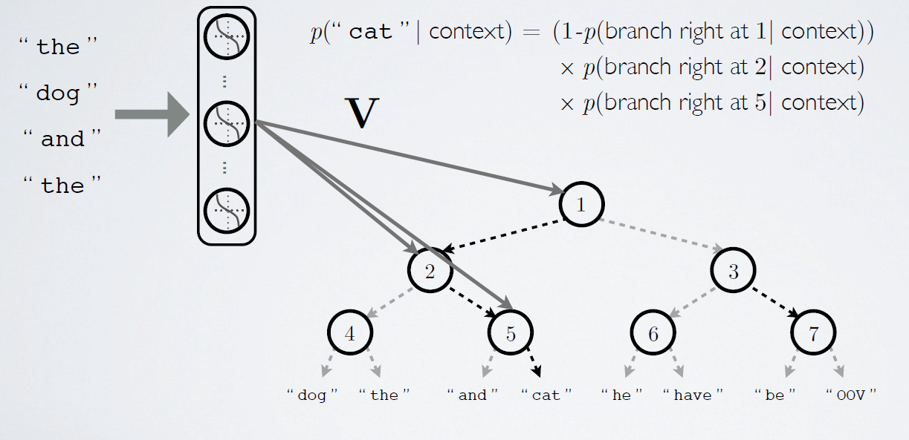
Inefficiency: Hierarchical Softmax
Neural Network Lectures by Hugo Leorchelle

Slide 10
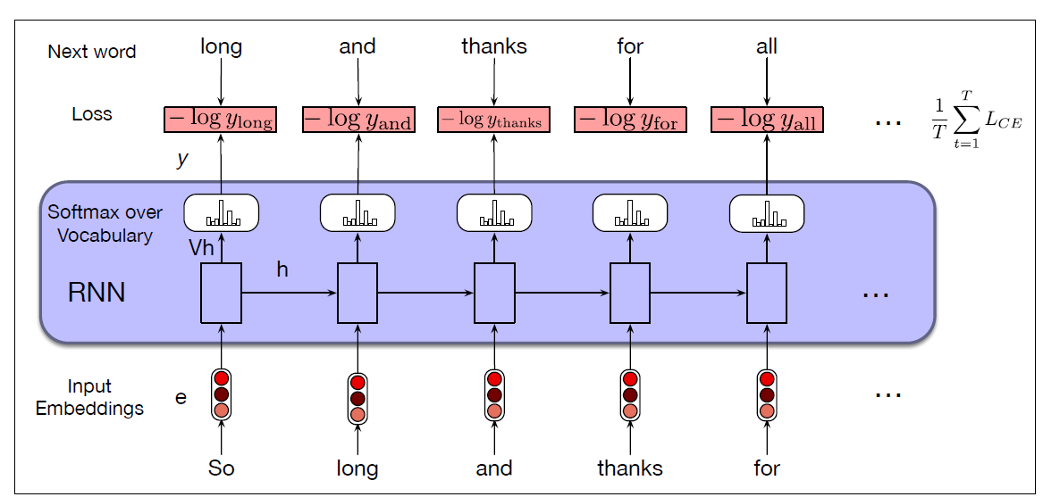
Limited Context and Sequential Nature: RNN-LM
Jurafsky and Martin, Speech and Language Processing, 3rd Draft Jan 2022 Ed

Slide 11
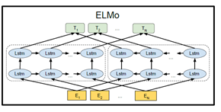
Unidirectional: ELMo
Source: Devlin et al. NAACL 2019

Slide 12



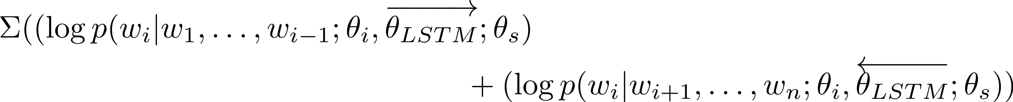
Unidirectional: ELMo
Source: Devlin et al. NAACL 2019

Slide 13
Issues with RNN-based LMs
Limited bi-directionality
Difficult to parallelize

Slide 14
Transformer-based LM
Era of Large-scale pre-trained neural language models

Slide 15
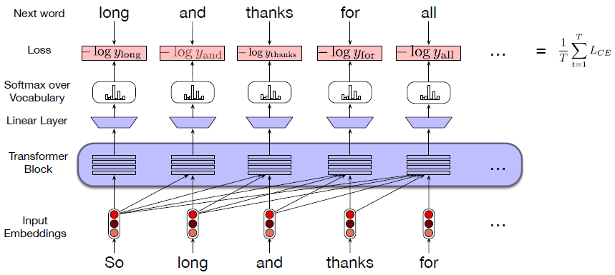
Vanilla Transformer Language Model
Jurafsky and Martin, Speech and Language Processing, 3rd Draft Jan 2022 Ed

Slide 16
Three Paradigms
Pre-train then fine-tune
Prompt-based learning
NLP as text generation

Slide 17
Paradigm
Pre-train then fine-tune

Slide 18
Three classes of Pre-trained LM (PLMs)
Decoder-only Models
Example: GPT
Encoder-only Models
Example: BERT
Encoder-Decoder Language Models
Example: BART, T5

Slide 19
Three Types of Training Objectives
Autoregressive (AR): Predicting next word given a set of previous words
Masking: Predict masked/hidden word, given words on both sides of it
Denoising Tasks: Correct the perturbation/corruption given in the input word sequence
Perturbation Examples: sentence permutation, span deletion etc.

Slide 20
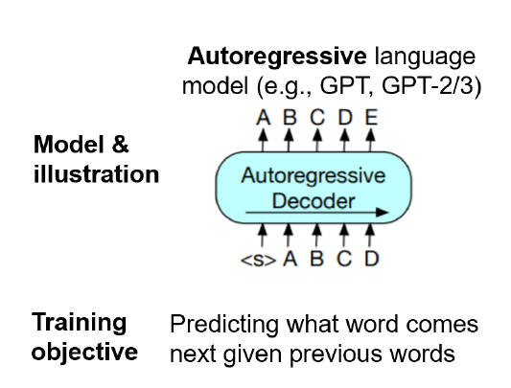
Autoregressive Language Models
Source: Min et al. arxiv:2111.01243v1 (ACM Computing Surveys)

Slide 21
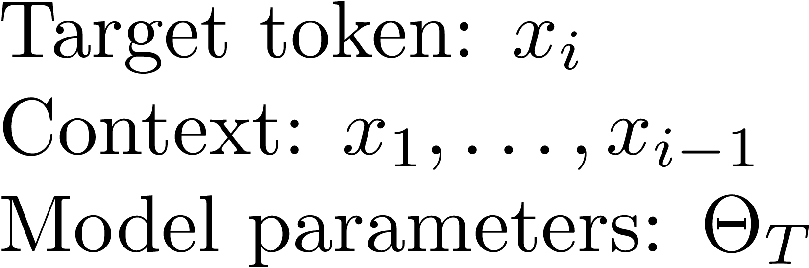
Autoregressive Language Models
Source: Min et al. arxiv:2111.01243v1 (ACM Computing Surveys)

Slide 22
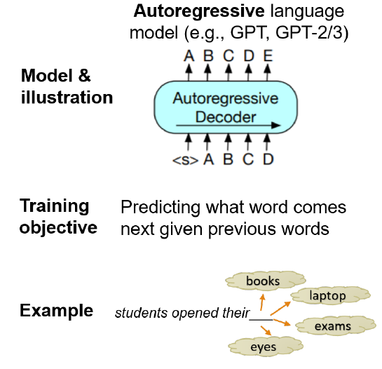
Autoregressive Language Models
Unidirectional
Taking sequential nature into account
Useful for natural language generation downstream tasks
Source: Min et al. arxiv:2111.01243v1 (ACM Computing Surveys)

Slide 23
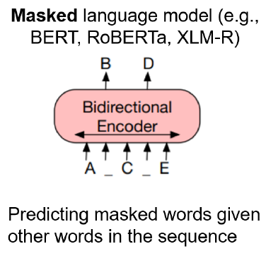
Masked Language Model
Source: Min et al. arxiv:2111.01243v1 (ACM Computing Surveys)

Slide 24
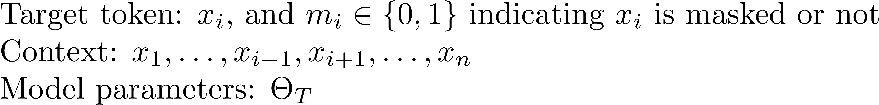
Masked Language Model
Source: Min et al. arxiv:2111.01243v1

Slide 25
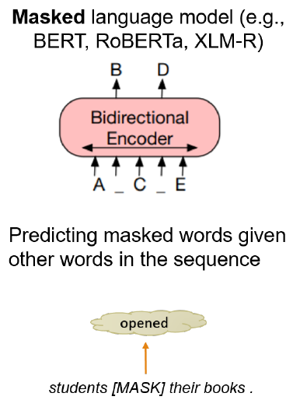
Masked Language Model
Inherently bi-directional
Non-autoregressive nature allows parallelized computation during inference
Making independence assumption
Issue with pretrain-finetune discrepancy due to corrupted input
Useful for classification tasks
Source: Min et al. arxiv:2111.01243v1 (ACM Computing Surveys)

Slide 26
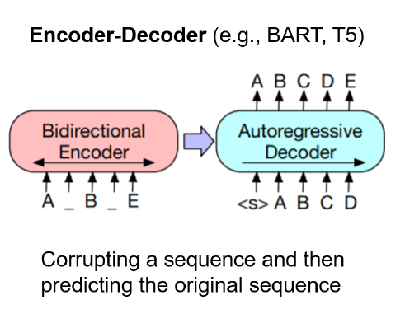
Encoder-Decoder Models
Source: Min et al. arxiv:2111.01243v1 (ACM Computing Surveys)

Slide 27
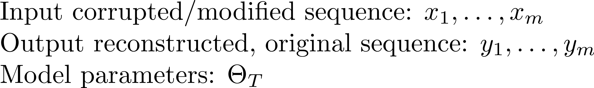
Encoder-Decoder Models
Source: Min et al. arxiv:2111.01243v1 (ACM Computing Surveys)

Slide 28
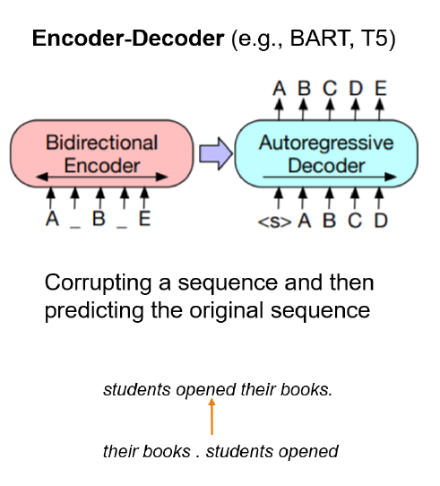
Encoder-Decoder Model
bi-directional and sequence to sequence learning
Combining the advantage of bi-directional and autoregressive models
Very convenient to fine-tune for seq2seq tasks (e.g. MT, Summarization etc.)
Reconstructed Original
Sequence: Output
Corrupted Sequence:
Input
Source: Min et al. arxiv:2111.01243v1 (ACM Computing Surveys)

Slide 29
Important aspects about pre-training corpora
Size
Quality (source data characteristics) and diversity
Domain of intended downstream tasks

Slide 30
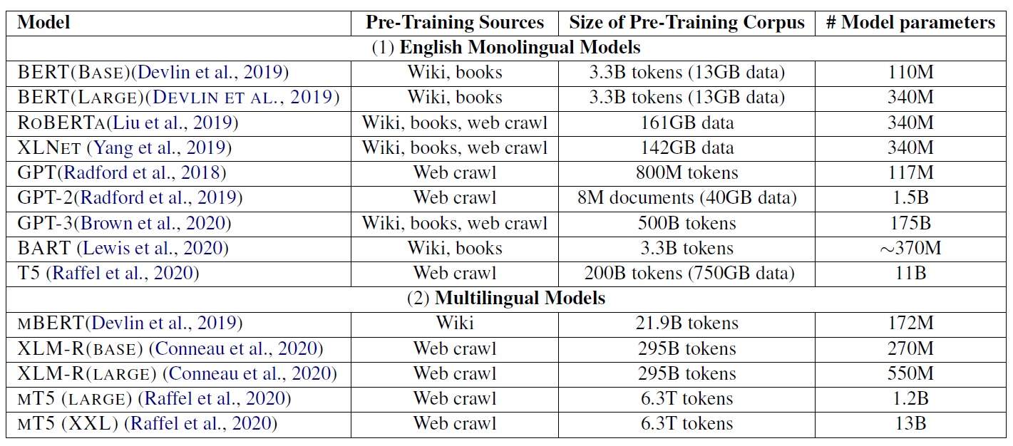
Pre-training corpora of a few LMs
Source: Min et al. arxiv:2111.01243v1 (ACM Computing Surveys)

Slide 31
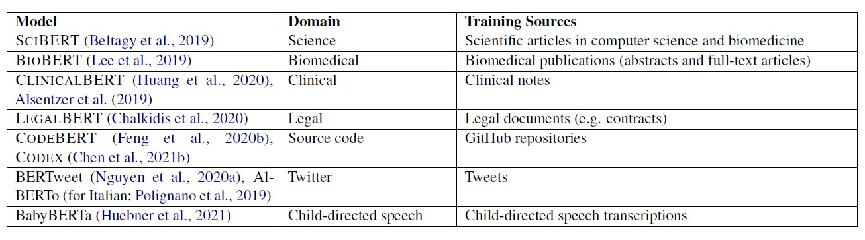
Pre-trained LMs on specific domain
Source: Min et al. arxiv:2111.01243v1 (ACM Computing Surveys)

Slide 32
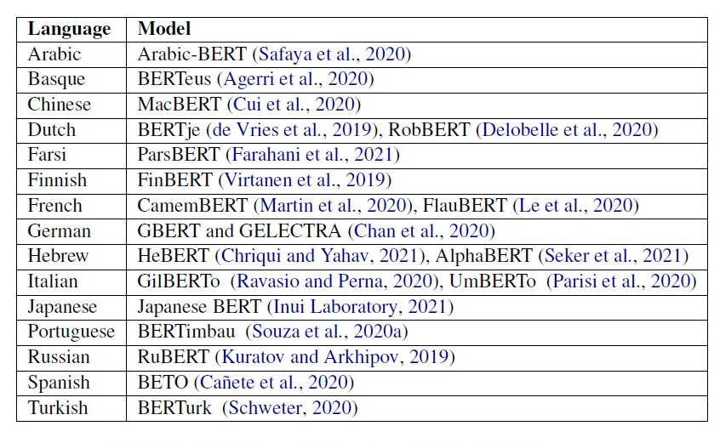
Pre-trained LMs on different languages
Source: Min et al. arxiv:2111.01243v1 (ACM Computing Surveys)

Slide 33
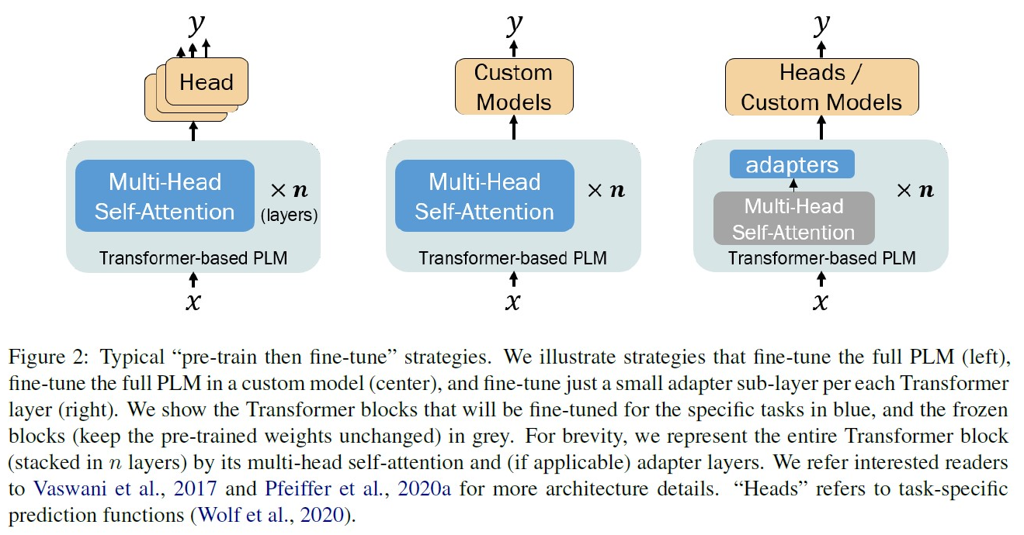
Fine-Tuning
Source: Min et al. arxiv:2111.01243v1 (ACM Computing Surveys)

Slide 34
Paradigm
Prompt Based Learning

Slide 35
What is prompting?
“adding natural language text or continuous vectors to the input or output to encourage PLMs to perform specific tasks”

Slide 36
Advantages
For in-context or in-domain learning, may not require to fine-tune PLMs, thus reduces computational requirements
Allows better alignment of the new task with the pre-train objective

Slide 37
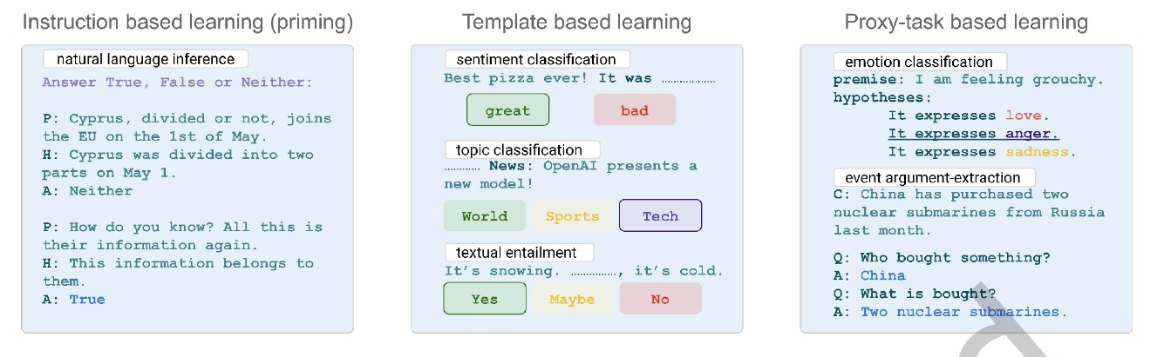
Main Prompt-based approaches
Source: Min et al. arxiv:2111.01243v1 (ACM Computing Surveys)

Slide 38
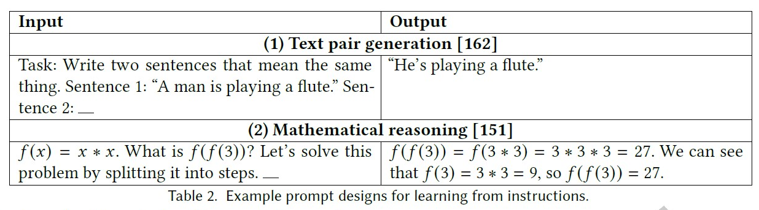
Instruction based prompting
Source: Min et al. arxiv:2111.01243v1 (ACM Computing Surveys)

Slide 39
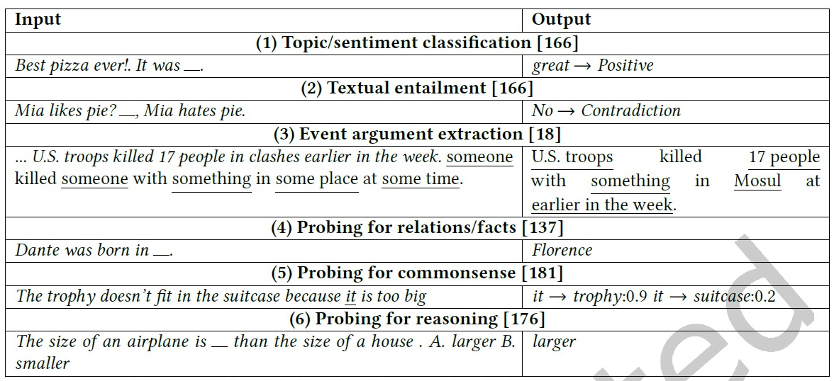
Template based prompting
Source: Min et al. arxiv:2111.01243v1 (ACM Computing Surveys)

Slide 40
Paradigm
NLP as text generation

Slide 41
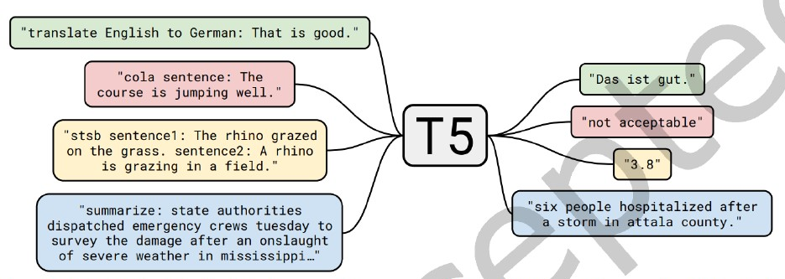
Source: Min et al. arxiv:2111.01243v1 (ACM Computing Surveys)

Slide 42
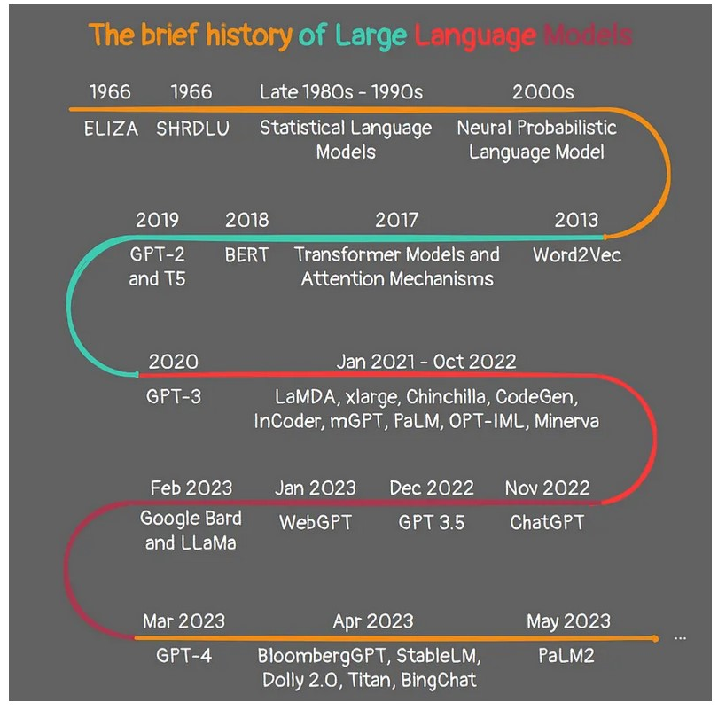
https://levelup.gitconnected.com/the-brief-history-of-large-language-models-a-journey-from-eliza-to-gpt-4-and-google-bard-167c614af5af

Slide 43
Summary of Paradigm Shifts
Statistical
Models
Move LMs from rule/grammar-based models to data-driven models
Probabilistic
Neural Models
Increased context
Word Embedding
Transformer
PLMs
Contextual Embedding
More generalized
Multi-modality
Multi-Task
Source: Min et al. arxiv:2111.01243v1

Slide 44
References
Jurafsky and Martin, Speech and Language Processing, 3rd Ed. Draft [Available at https://web.stanford.edu/~jurafsky/slp3/ ]
Min et al., Recent advances in natural language processing via large pre-trained language models: A survey. ACM Computing Surveys

Slide 45
Thanks! Question and Comments!

